Slide 1
Introduction to Computation
Fan Cheng Shanghai Jiao Tong University
http://www.cs.sjtu.edu.cn/~chengfan/
chengfan@sjtu.edu.cn
Autumn, 2022

Slide 2
Outline
Class
Module

Slide 3
The big picture
一个单独的文件就是一个module
Python module—the highest-level program organization unit, which packages program code and data for reuse, and provides self contained namespaces that minimize variable name clashes across your programs.
In concrete terms, modules typically correspond to Python program files.
Each file is a module, and modules import other modules to use the names they define.
Modules are processed with two statements and one important function:
import
Lets a client (importer) fetch a module as a whole
from
Allows clients to fetch particular names from a module
imp.reload (reload in 2.X)
Provides a way to reload a module’s code without stopping Python)
In short, modules provide an easy way to organize components into a system by serving as self-contained packages of variables known as namespaces (名空间).

Slide 4
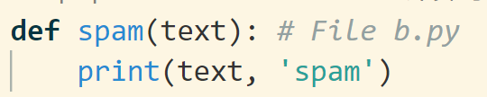
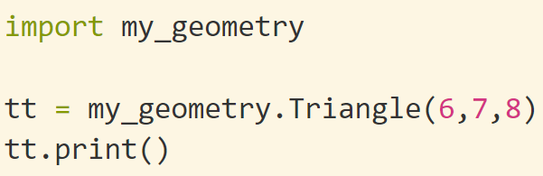
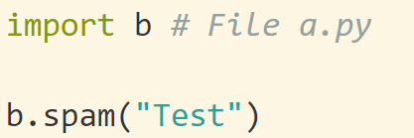

import
import math
print(math.sin(math.pi/3))
语法：import moduleName
由于moduleName就是文件名，所以python的文件名必须符合python的变量定义规则
在文件b.py中定义函数spam(). 在文件a.py中import b并且调用b.spam(). 运行a.py
在文件my_geometry.py中定义Triangle类. 在另一文件中import并运行
b.py和my_geometry.py都是python文件，都可以作为module导入(import)

Slide 5
Top-level file (顶层文件)
模块之间import，其执行顺序和函数调用类似
At a base level, a Python program consists of text files containing Python statements, with
one main top-level file (当前运行的文件)
zero or more supplemental files known as modules (被import的文件)
The top-level (a.k.a. script) file contains the main flow of control of your program—this is the file you run to launch your application.
The module files are libraries of tools used to collect components used by the top-level file, and possibly elsewhere. Top-level files use tools defined in module files, and modules use tools defined in other modules.
A file imports a module to gain access to the tools it defines, which are known as its attributes—variable names attached to objects such as functions. Ultimately, we import modules and access their attributes to use their tools.
import math
math.pi
math.sin(x)
Top-level: 自己当家作主，调用其他模块
Imported module: 打工人

Slide 6
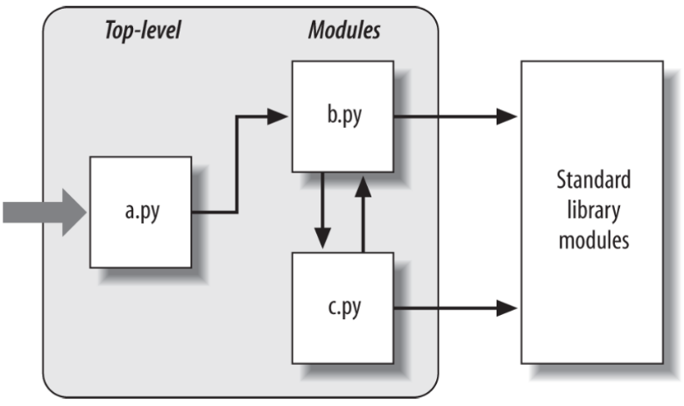
Python Program Architecture
Program architecture in Python. A program is a system of modules
It has one top-level (顶层) script file (launched to run the program), and multiple module files (imported libraries of tools)
Scripts and modules are both text files containing Python statements, though the statements in modules usually just create objects to be used later
Python’s standard library provides a collection of precoded modules
The file a.py is chosen to be the top-level file; it will be a simple text file of statements, which is executed from top to bottom when launched. The files b.py and c.py are modules; they are simple text files of statements as well, but they are not usually launched directly. Instead, as explained previously, modules are normally imported by other files that wish to use the tools the modules define

Slide 7
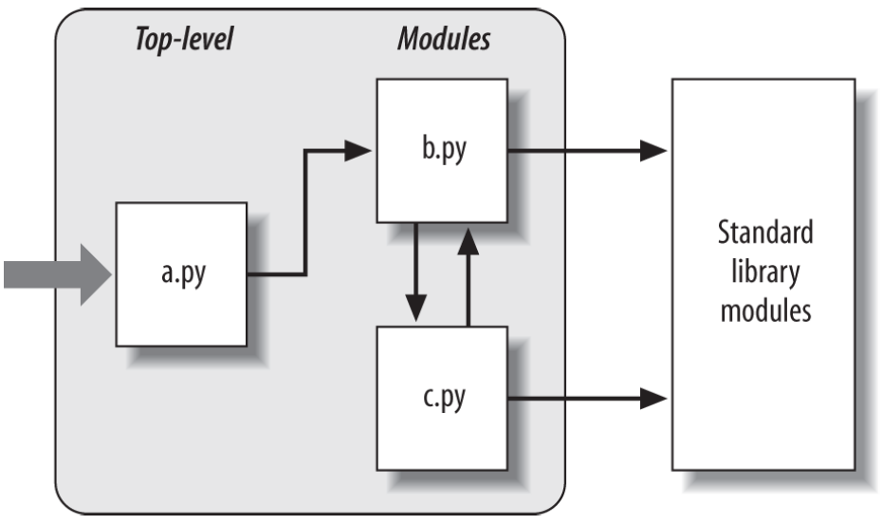
Python Program Architecture: import
上海市.闵行区.上海交通大学
上海市.徐汇区.上海交通大学
The first of these, a Python import statement, gives the file a.py access to everything defined by top-level code in the file b.py.
The code import b roughly means:
Load the file b.py (unless it’s already loaded), and give me access to all its attributes through the name b.
In fact, the module name used in an import statement serves two purposes: it identifies the external file to be loaded, but it also becomes a variable assigned to the loaded module.
The code b.spam means:
Fetch the value of the name spam that lives within the object b.

Slide 8
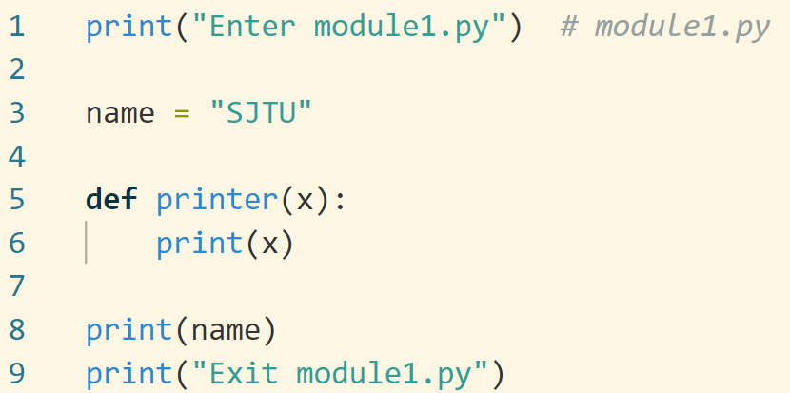
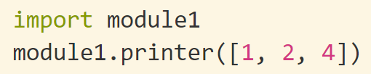
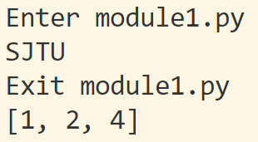
import
Objects defined by a module are also created at runtime, as the import is executing:
import literally runs statements in the target file one at a time to create its contents.
被import的文件的每一条语句都会被执行一遍

Slide 9
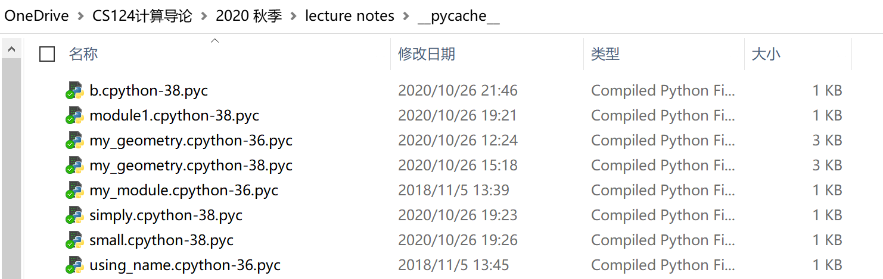
How import works
They are really runtime operations that perform three distinct steps the first time a program imports a given file:
1. Find the module’s file.
2. Compile it to byte code (if needed). Byte Code Files: __pycache__ in Python
3. Run the module’s code to build the objects it defines.

Slide 10
The module search path
import时寻找模块的步骤
1. The home directory of the program
2. PYTHONPATH directories (if set)
3. Standard library directories
4. The contents of any .pth files (if present)
5. The site-packages home of third-party extensions

Slide 11

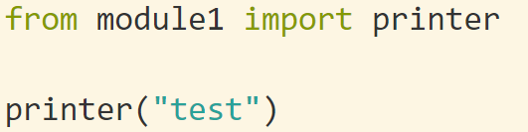
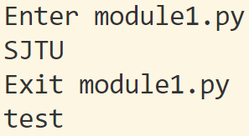
import, from…import
import moduel1
module1.printer(‘Hello world!’)
from moduel1 import printer
printer('Hello world!’)
from module1 import *
printer('Hello world!’)
*：通配符，代表 “所有, 全部, 任意”
from xxx import xxx的文件的每一条语句也都会被执行一遍

Slide 12

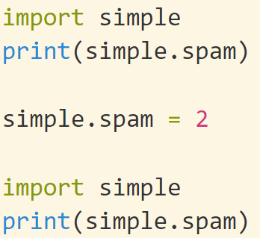
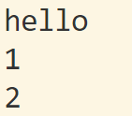
Imports Happen Only Once
Modules are loaded and run on the first import or from, and only the first.
This is on purpose—because importing is an expensive operation, by default Python does it just once per file, per process. Later import operations simply fetch the already loaded module object.

Slide 13
import and from Equivalence
At least conceptually, a from statement like this one:
from module import name1, name2 # Copy these two names out (only)
is equivalent to this statement sequence:
import module # Fetch the module object
name1 = module.name1 # Copy names out by assignment
name2 = module.name2
del module # Get rid of the module name
Like all assignments, the from statement creates new variables in the importer, which initially refer to objects of the same names in the imported file. Only the names are copied out, though, not the objects they reference, and not the name of the module itself. When we use the from * form of this statement (from module import *), the equivalence is the same, but all the top-level names in the module are copied over to the importing scope this way.

Slide 14
Reload modules
In a nutshell:
• Imports (via both import and from statements) load and run a module’s code only the first time the module is imported in a process
• Later imports use the already loaded module object without reloading or rerunning the file’s code
• The reload function forces an already loaded module’s code to be reloaded and rerun
Unlike import and from:
• reload is a function in Python, not a statement.
• reload is passed an existing module object, not a new name.
• reload lives in a module in Python 3.X and must be imported itself.
from imp import reload
reload(moduleName)

Slide 15
as (别名)
import modulename as name # And use name, not modulename
is equivalent to the following, which renames the module in the importer’s scope only (it’s still known by its original name to other files):
import modulename
name = modulename
del modulename # Don't keep original name
After such an import, you can—and in fact must—use the name listed after the as to refer to the module. This works in a from statement, too, to assign a name imported from a file to a different name in the importer’s scope; as before you get only the new name you provide, not its original:
from modulename import attrname as name
import reallylongmodulename as name # Use shorter nickname
name.func()
from module1 import utility as util1 # Can have only 1 "utility"
from module2 import utility as util2
util1(); util2()
import numpy as np

Slide 16
__future__
Changes to the language that may potentially break existing code are usually introduced
gradually in Python. They often initially appear as optional extensions, which are disabled
by default. To turn on such extensions, use a special import statement of this form:
from __future__ import featurename
When used in a script, this statement must appear as the first executable statement in
the file (possibly following a docstring or comment), because it enables special compilation
of code on a per-module basis. It’s also possible to submit this statement at the
interactive prompt to experiment with upcoming language changes; the feature will
then be available for the remainder of the interactive session.
必须第一行
列子：在py2.0环境下使用py3.0的语法

Slide 17
__name__ and __main__
Top-level: 自己当家作主，调用其他模块
Imported module: 打工人
Both import a file as a module and run it as a standalone program, is widely used in Python files.
Each module has a built-in attribute called __name__, which Python creates and assigns automatically as follows:
• If the file is being run as a top-level program file, __name__ is set to the string
"__main__" when it starts.
• If the file is being imported instead, __name__ is set to the module’s name as known by its clients.
The upshot is that a module can test its own __name__ to determine whether it’s being run or imported.
In effect, a module’s __name__ variable serves as a usage mode flag, allowing its code to be leveraged as both an importable library and a top-level script.

Slide 18
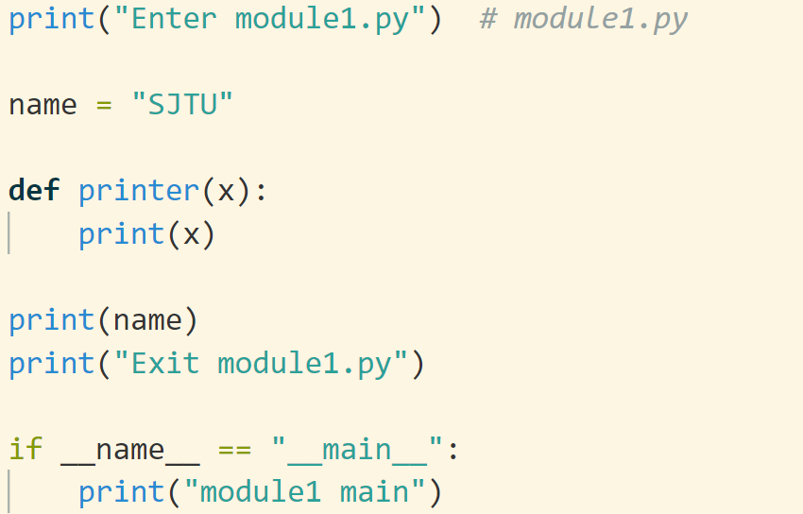

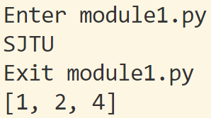
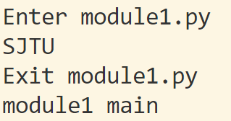
Top-level Vs. Imported

Slide 19
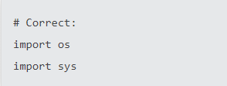


import
From Lec. 7
Imports are always put at the top of the file, just after any module comments and docstrings, and before module globals and constants.
Imports should be grouped in the following order:
Standard library imports.
Related third party imports.
Local application/library specific imports.
You should put a blank line between each group of imports.
Absolute imports are recommended, as they are usually more readable and tend to be better behaved
Wildcard imports (from <module> import *) should be avoided

Slide 20
Useful Module
Matplotlib : plot figures
Numpy: numerical computing
Scipy: scientific computing
Pandas: data analysis
Scrapy: Crawler
Beautiful soup: pulling data out of HTML and XML files
Game
Pygame: pip3 install pygame
To see if it works, run one of the included examples:
python3 -m pygame.examples.aliens

Slide 21
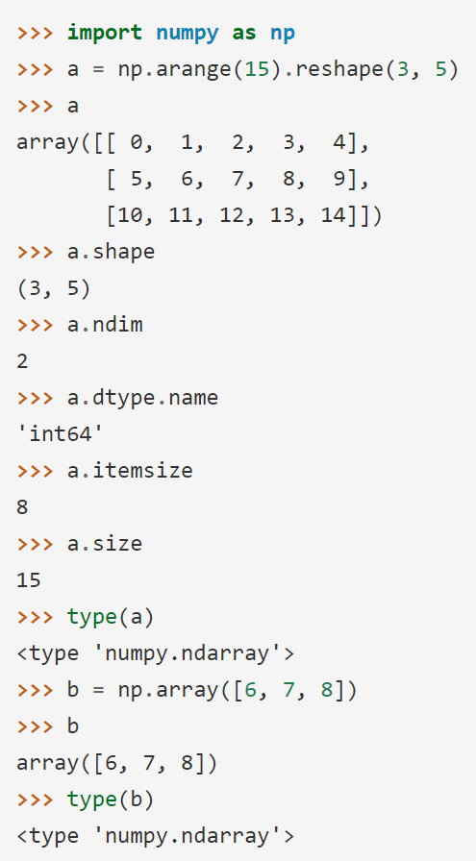
Numpy
NumPy is the fundamental package for scientific computing with Python. It contains among other things:
a powerful N-dimensional array object
sophisticated (broadcasting) functions
tools for integrating C/C++ and Fortran code
useful linear algebra, Fourier transform, and random number capabilities
https://numpy.org/
务必自学

Slide 22
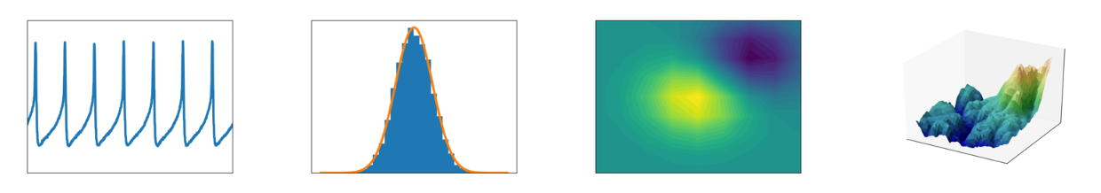
Matplotlib
Matplotlib is a Python 2D plotting library which produces publication quality figures in a variety of hardcopy formats and interactive environments across platforms. Matplotlib can be used in Python scripts, the Python and IPython shells, the Jupyter notebook, web application servers, and four graphical user interface toolkits.
https://matplotlib.org/index.html

Slide 23
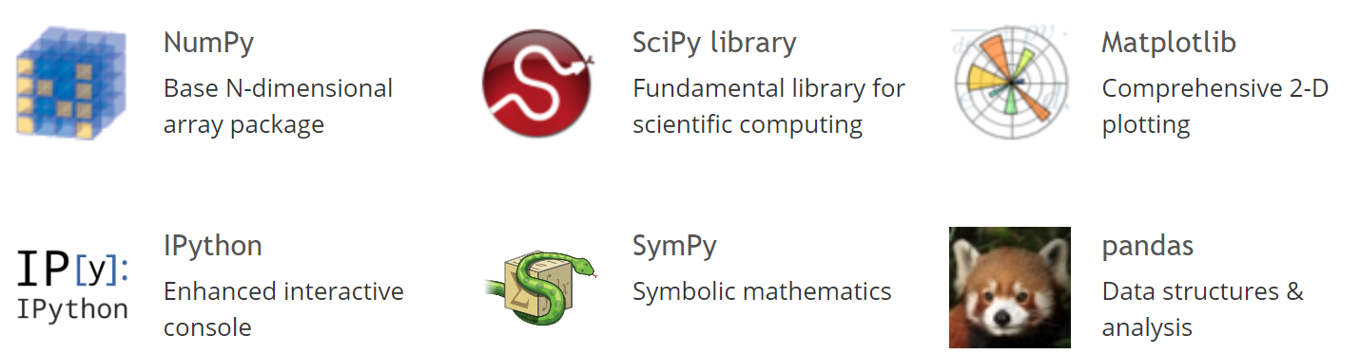
Scipy
SciPy (pronounced “Sigh Pie”) is a Python-based ecosystem of open-source software for mathematics, science, and engineering. In particular, these are some of the core packages:
https://www.scipy.org/

Slide 24

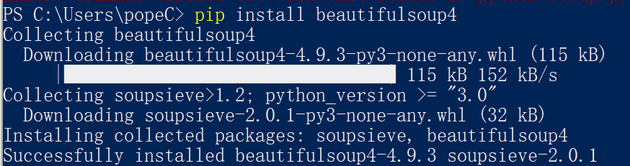
Pip: Module Management
Package installer for Python: https://pypi.org/project/pip/
pip is a de facto standard package-management system used to install and manage software packages written in Python
Many packages can be found in the default source for packages and their dependencies — Python Package Index
Most distributions of Python come with pip preinstalled
xxx.whl: A WHL file is a package saved in the Wheel format, which is the standard built-package format used for Python distributions
Quickstart: https://pip.pypa.io/en/stable/quickstart/
Usage
pip install SomePackage
pip install --upgrade SomePackage
pip uninstall SomePackage
pip install xxx 网络安装
Pip install xxx.whl 本地安装

Slide 25
Reading
Learning Python: Part V. Modules and Packages

